Slide 1
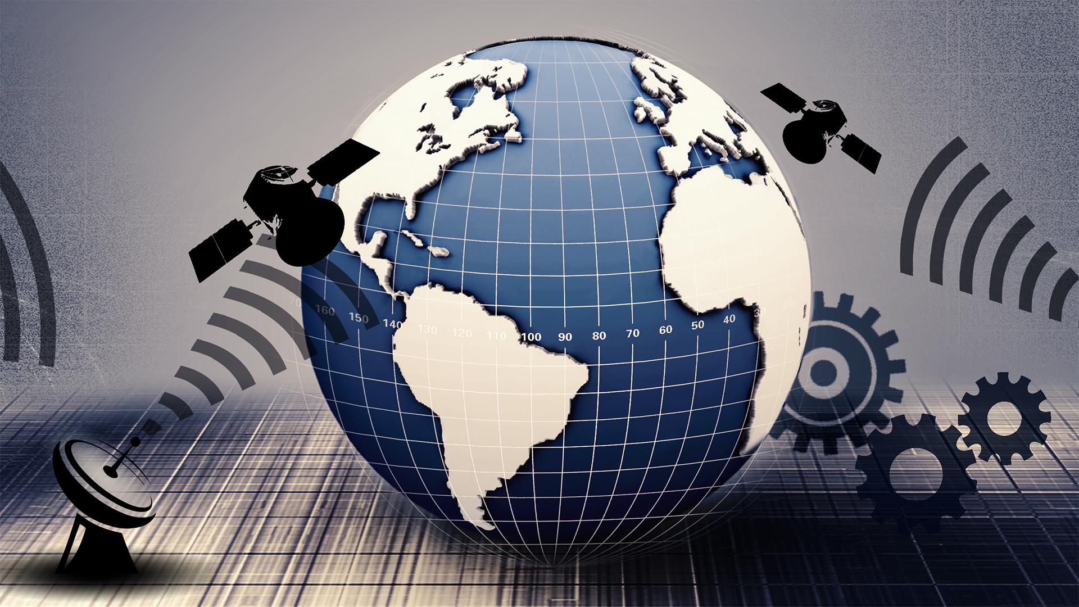

Satellite Orbit Determination (AE4872) Homework Assignments
Dr. Christian Siemes
Section: Astrodynamics and Space Missions

Slide 2
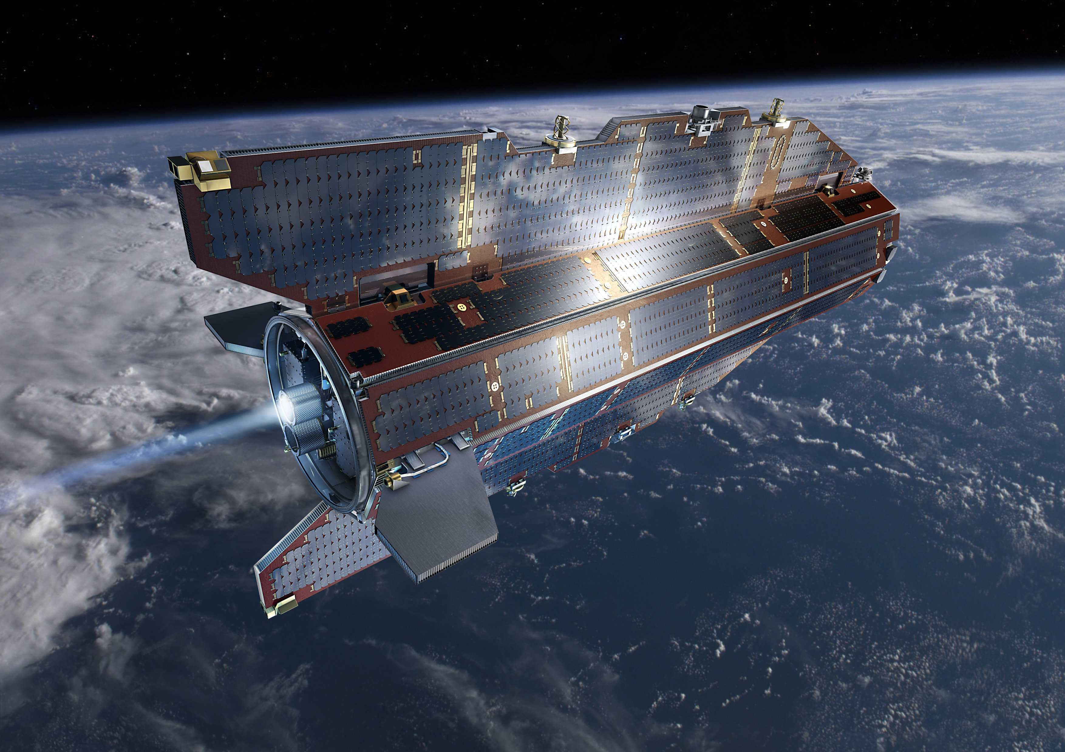
Learning objectives
At the end of the instruction session, you should be able to
Estimate satellite orbits from dynamics and observations
Method is comparable to the onboard navigation solution

Slide 3

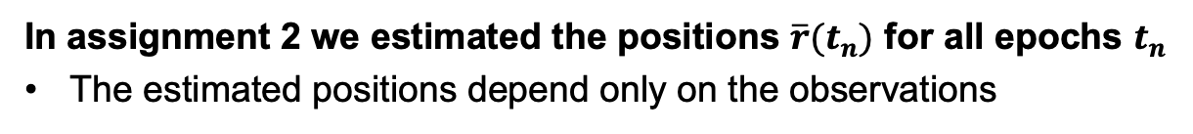
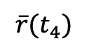
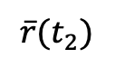
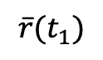
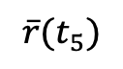
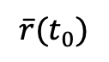
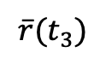
Point positioning using observations (assignment 2)
In assignment 2 we estimated the positions $\overline{r}(t_{n})$ for all epochs $t_{n}$
The estimated positions depend only on the observations
$$\overline{r}(t_{1})$$
$$\overline{r}(t_{2})$$
$$\overline{r}(t_{3})$$
$$\overline{r}(t_{0})$$
$$\overline{r}(t_{4})$$
$$\overline{r}(t_{5})$$

Slide 4
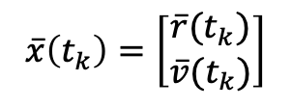
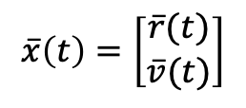
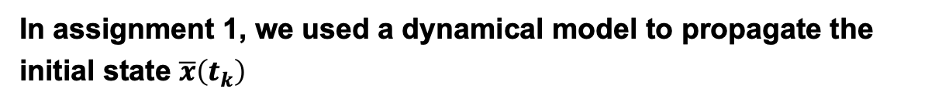
Dynamics (assignment 1)
In assignment 1, we used a dynamical model to propagate the initial state $\overline{x}\left(t_{k}\right)$
$$\overline{x}\left(t_{k}\right)=\left[\begin{matrix}\overline{r}(t_{k}) \\ \overline{v}(t_{k})\end{matrix}\right]$$
$$\overline{x}\left(t\right)=\left[\begin{matrix}\overline{r}(t) \\ \overline{v}(t)\end{matrix}\right]$$

Slide 5
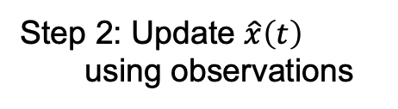
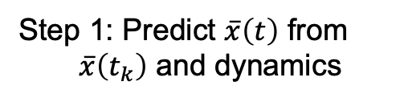
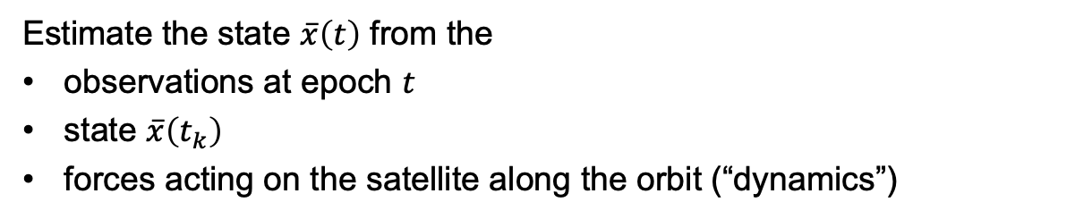
Dynamics and observations (assignment 3)
Estimate the state $\overline{x}\left(t\right)$ from the
observations at epoch $t$
state $\overline{x}\left(t_{k}\right)$
forces acting on the satellite along the orbit (“dynamics”)
Step 2: Update $\hat{x}\left(t\right)$ using observations
$$\overline{x}\left(t_{k}\right)=\left[\begin{matrix}\overline{r}(t_{k}) \\ \overline{v}(t_{k})\end{matrix}\right]$$
Step 1: Predict $\overline{x}\left(t\right)$ from $\overline{x}\left(t_{k}\right)$ and dynamics

Slide 6
Content
Including dynamics
State transition matrix and sensitivity matrix
Numerical integration
Acceleration in rotating reference frames
Combining observations and dynamics
Kalman filter
Process noise

Slide 7
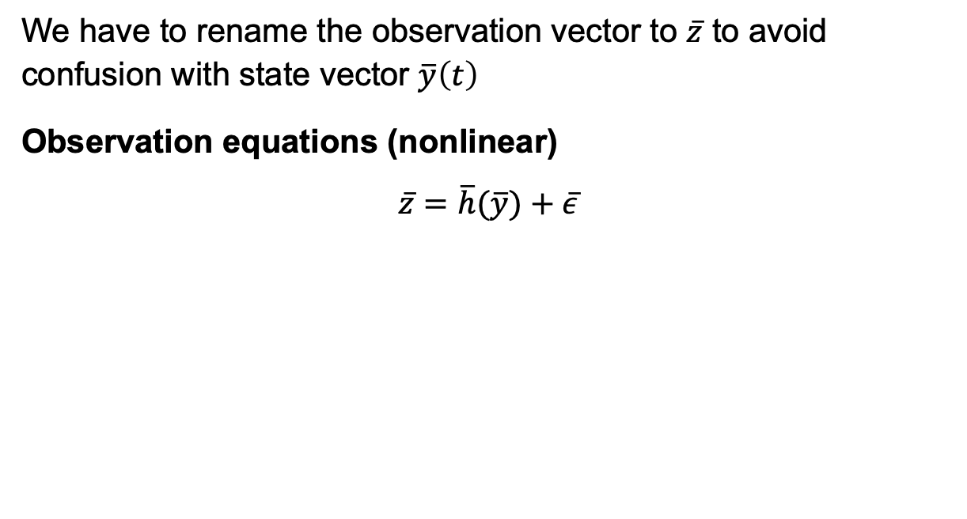
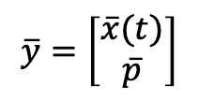
From point positioning to initial state estimation
We have to rename the observation vector to $\overline{z}$ to avoid confusion with state vector $\overline{y}\left(t\right)$
Observation equations (nonlinear)
$$\overline{z}=\overline{h}(\overline{y})+\overline{ε}$$
State vector
(position and velocity)
$$\overline{y}=\left[\begin{matrix}\overline{x}(t) \\ \overline{p}\end{matrix}\right]$$
Force parameters
(drag, radiation pressure,…)

Slide 8
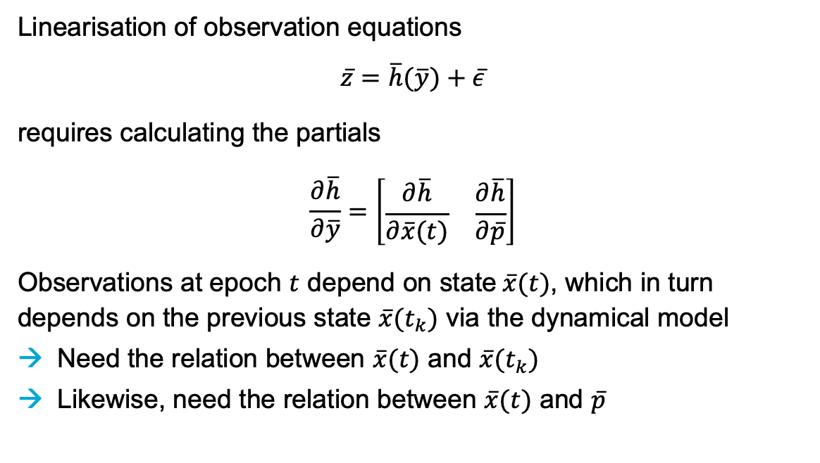
From point positioning to initial state estimation
Linearisation of observation equations
$$\overline{z}=\overline{h}(\overline{y})+\overline{ε}$$
requires calculating the partials
$$\frac{∂\overline{h}}{∂\overline{y}}=\left[\begin{matrix}\frac{∂\overline{h}}{∂\overline{x}(t)} & \frac{∂\overline{h}}{∂\overline{p}}\end{matrix}\right]$$
Observations at epoch $t$ depend on state$\overline{x}(t)$, which in turn depends on the previous state $\overline{x}(t_{k})$ via the dynamical model
Need the relation between $\overline{x}(t)$ and $\overline{x}(t_{k})$
Likewise, need the relation between $\overline{x}(t)$ and $\overline{p}$

Slide 9
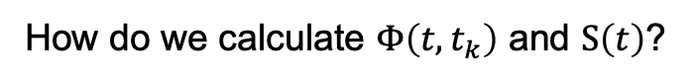
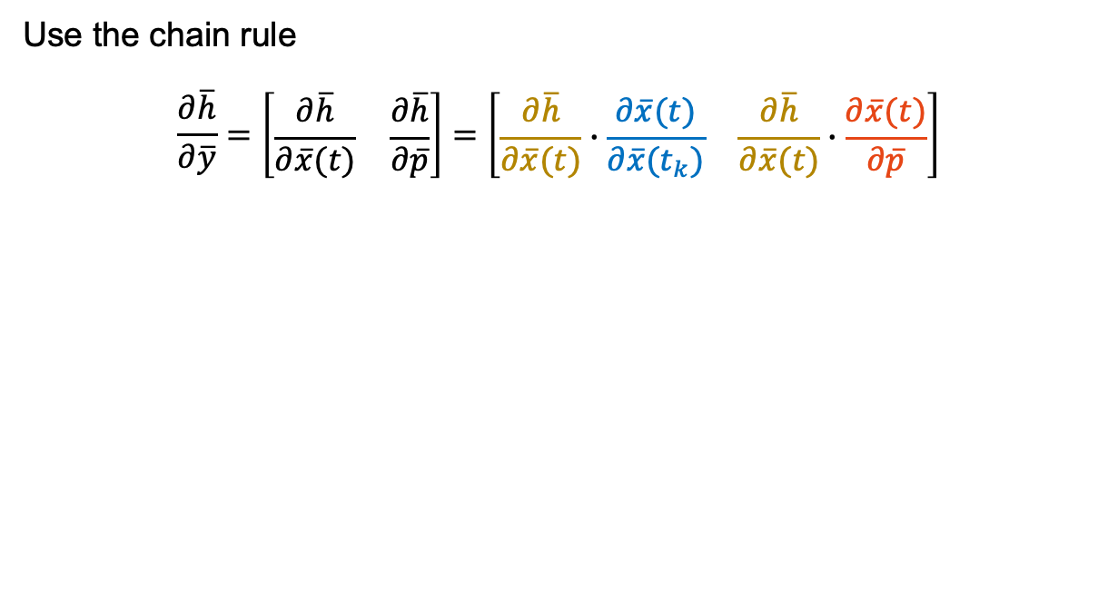
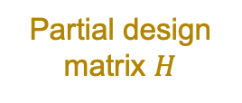
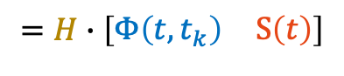
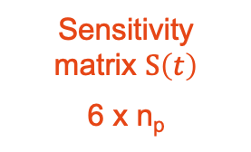
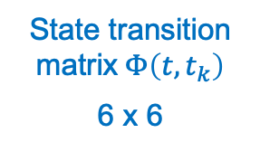
State transition matrix and sensitivity matrix
Partial design matrix $H$
Use the chain rule
$$\frac{∂\overline{h}}{∂\overline{y}}=\left[\begin{matrix}\frac{∂\overline{h}}{∂\overline{x}(t)} & \frac{∂\overline{h}}{∂\overline{p}}\end{matrix}\right]=\left[\begin{matrix}\frac{∂\overline{h}}{∂\overline{x}(t)}∙\frac{∂\overline{x}(t)}{∂\overline{x}(t_{k})} & \frac{∂\overline{h}}{∂\overline{x}(t)}∙\frac{∂\overline{x}(t)}{∂\overline{p}}\end{matrix}\right]$$
$$=H∙\left[\begin{matrix}Φ\left(t,t_{k}\right) & S\left(t\right)\end{matrix}\right]$$
State transition matrix$Φ\left(t,t_{k}\right)$
6 x 6
Sensitivity matrix $S\left(t\right)$
6 x n_{p}
How do we calculate $Φ\left(t,t_{k}\right)$ and $S\left(t\right)$?
Our derivation follows Montenbruck and Gill, Satellite Orbits. Chapter 7. Springer, 2000

Slide 10
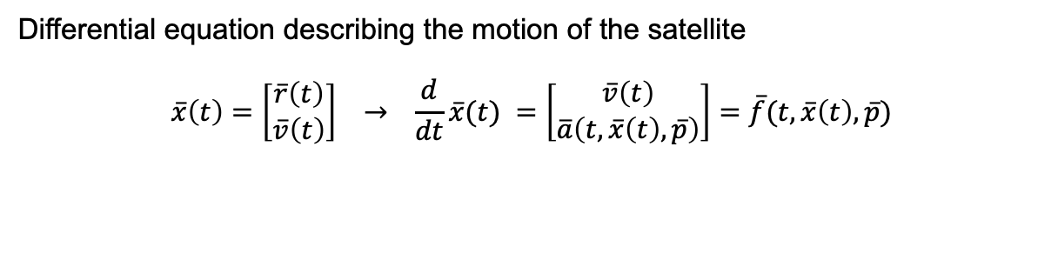
State transition matrix and sensitivity matrix
Differential equation describing the motion of the satellite
$$\overline{x}\left(t\right)=\left[\begin{matrix}\overline{r}\left(t\right) \\ \overline{v}\left(t\right)\end{matrix}\right] → \frac{d}{dt}\overline{x}(t) =\left[\begin{matrix}\overline{v}\left(t\right) \\ \overline{a}\left(t,\overline{x}\left(t\right),\overline{p}\right)\end{matrix}\right]=\overline{f}(t,\overline{x}\left(t\right),\overline{p})$$
Examples:
Drag (depends on velocity)
Gravity field coefficients
(depend on position)

Slide 11
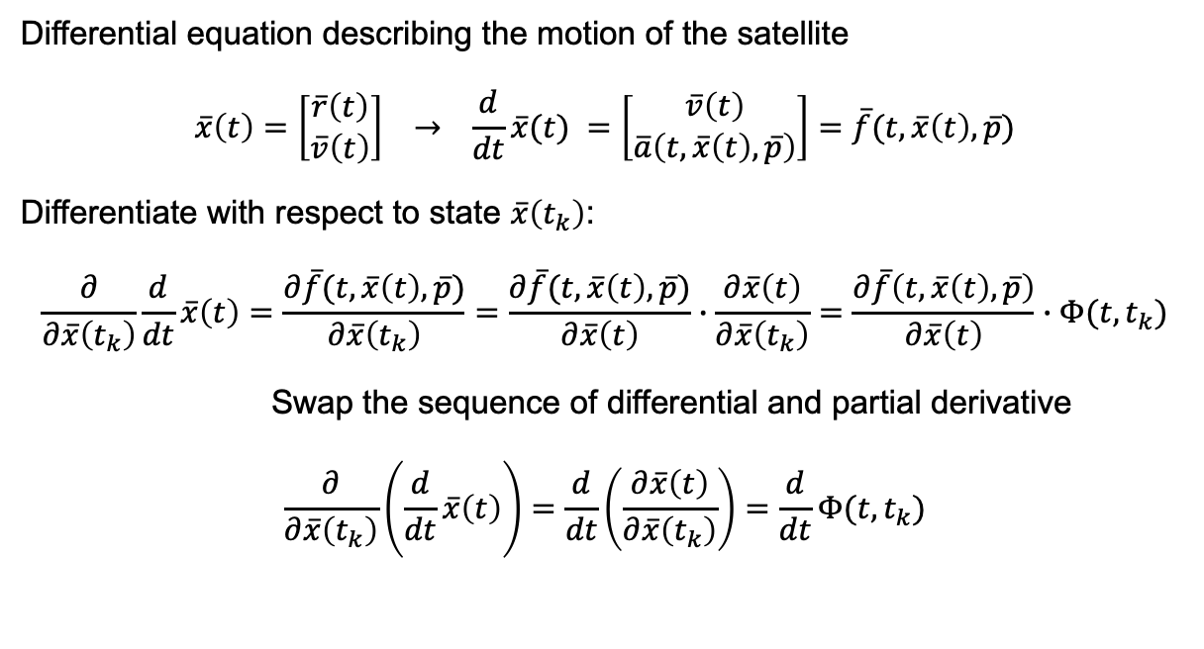
State transition matrix and sensitivity matrix
Differential equation describing the motion of the satellite
$$\overline{x}\left(t\right)=\left[\begin{matrix}\overline{r}\left(t\right) \\ \overline{v}\left(t\right)\end{matrix}\right] → \frac{d}{dt}\overline{x}(t) =\left[\begin{matrix}\overline{v}\left(t\right) \\ \overline{a}\left(t,\overline{x}\left(t\right),\overline{p}\right)\end{matrix}\right]=\overline{f}(t,\overline{x}\left(t\right),\overline{p})$$
Differentiate with respect to state $\overline{x}\left(t_{k}\right)$:
$$\frac{∂}{∂\overline{x}\left(t_{k}\right)}\frac{d}{dt}\overline{x}\left(t\right)=\frac{∂\overline{f}(t,\overline{x}\left(t\right),\overline{p})}{∂\overline{x}\left(t_{k}\right)}=\frac{∂\overline{f}(t,\overline{x}\left(t\right),\overline{p})}{∂\overline{x}\left(t\right)}∙\frac{∂\overline{x}\left(t\right)}{∂\overline{x}\left(t_{k}\right)}=\frac{∂\overline{f}\left(t,\overline{x}\left(t\right),\overline{p}\right)}{∂\overline{x}\left(t\right)}∙Φ(t,t_{k})$$
Swap the sequence of differential and partial derivative
$$\frac{∂}{∂\overline{x}\left(t_{k}\right)}\left(\frac{d}{dt}\overline{x}\left(t\right)\right)=\frac{d}{dt}\left(\frac{∂\overline{x}\left(t\right)}{∂\overline{x}\left(t_{k}\right)}\right)=\frac{d}{dt}Φ(t,t_{k})$$

Slide 12
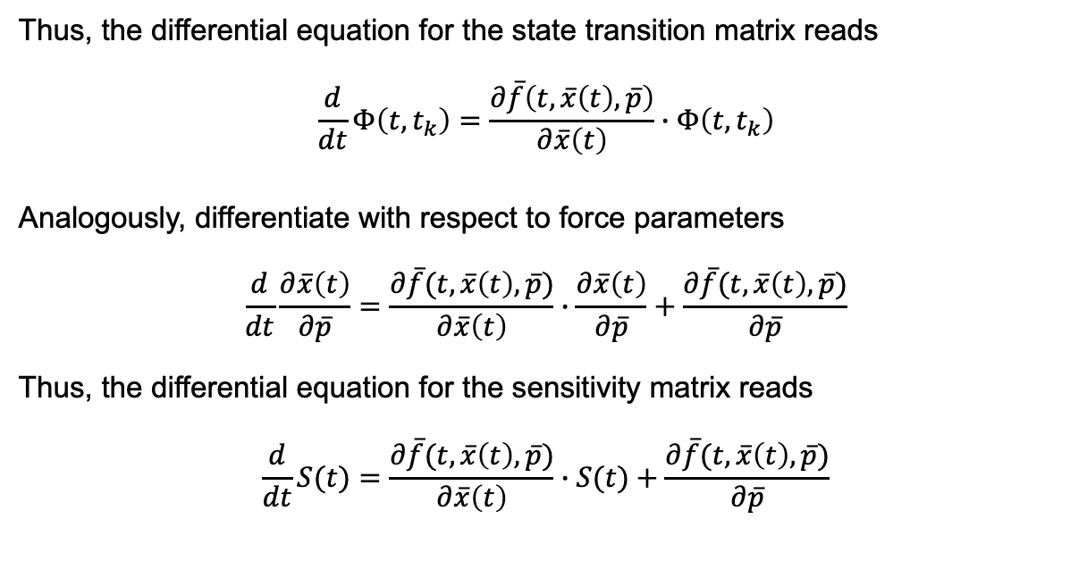
State transition matrix and sensitivity matrix
Thus, the differential equation for the state transition matrix reads
$$\frac{d}{dt}Φ\left(t,t_{k}\right)=\frac{∂\overline{f}\left(t,\overline{x}\left(t\right),\overline{p}\right)}{∂\overline{x}\left(t\right)}∙Φ\left(t,t_{k}\right)$$
Analogously, differentiate with respect to force parameters
$$\frac{d}{dt}\frac{∂\overline{x}\left(t\right)}{∂\overline{p}}=\frac{∂\overline{f}(t,\overline{x}\left(t\right),\overline{p})}{∂\overline{x}\left(t\right)}∙\frac{∂\overline{x}\left(t\right)}{∂\overline{p}}+\frac{∂\overline{f}(t,\overline{x}\left(t\right),\overline{p})}{∂\overline{p}}$$
Thus, the differential equation for the sensitivity matrix reads
$$\frac{d}{dt}S(t)=\frac{∂\overline{f}(t,\overline{x}\left(t\right),\overline{p})}{∂\overline{x}\left(t\right)}∙S(t)+\frac{∂\overline{f}(t,\overline{x}\left(t\right),\overline{p})}{∂\overline{p}}$$
Direct:
Forces acting at epoch t
Indirect:
State depends on “history” of force parameters

Slide 13
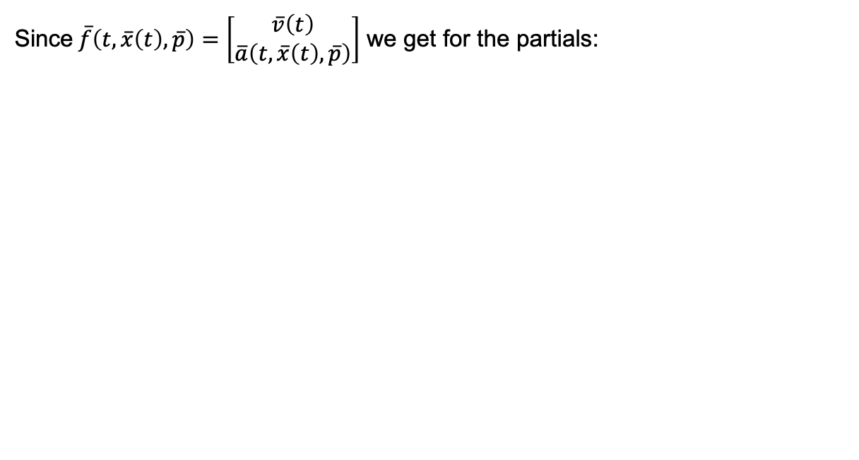
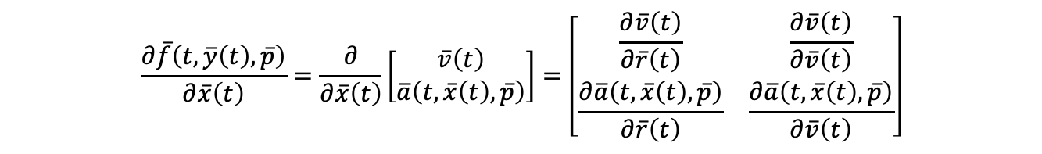
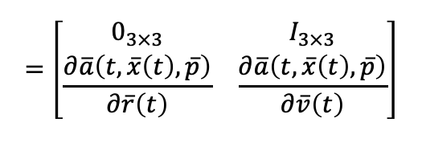
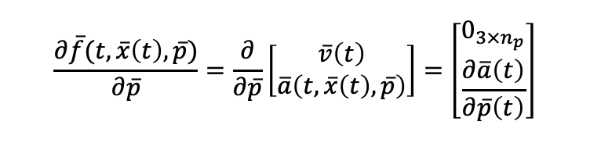
State transition matrix and sensitivity matrix
Since$\overline{f}\left(t,\overline{x}\left(t\right),\overline{p}\right)=\left[\begin{matrix}\overline{v}\left(t\right) \\ \overline{a}\left(t,\overline{x}\left(t\right),\overline{p}\right)\end{matrix}\right]$ we get for the partials:
$$\frac{∂\overline{f}\left(t,\overline{y}\left(t\right),\overline{p}\right)}{∂\overline{x}\left(t\right)}=\frac{∂}{∂\overline{x}\left(t\right)}\left[\begin{matrix}\overline{v}\left(t\right) \\ \overline{a}\left(t,\overline{x}\left(t\right),\overline{p}\right)\end{matrix}\right]=\left[\begin{matrix}\frac{∂\overline{v}\left(t\right)}{∂\overline{r}\left(t\right)} & \frac{∂\overline{v}\left(t\right)}{∂\overline{v}\left(t\right)} \\ \frac{∂\overline{a}\left(t,\overline{x}\left(t\right),\overline{p}\right)}{∂\overline{r}\left(t\right)} & \frac{∂\overline{a}\left(t,\overline{x}\left(t\right),\overline{p}\right)}{∂\overline{v}\left(t\right)}\end{matrix}\right]$$
Identity matrix
$$=\left[\begin{matrix}0_{3×3} & I_{3×3} \\ \frac{∂\overline{a}\left(t,\overline{x}\left(t\right),\overline{p}\right)}{∂\overline{r}\left(t\right)} & \frac{∂\overline{a}\left(t,\overline{x}\left(t\right),\overline{p}\right)}{∂\overline{v}\left(t\right)}\end{matrix}\right]$$
Zero matrix
6 x 6 matrix
$$\frac{∂\overline{f}(t,\overline{x}\left(t\right),\overline{p})}{∂\overline{p}}=\frac{∂}{∂\overline{p}}\left[\begin{matrix}\overline{v}\left(t\right) \\ \overline{a}\left(t,\overline{x}\left(t\right),\overline{p}\right)\end{matrix}\right]=\left[\begin{matrix}0_{3×n_{p}} \\ \frac{∂\overline{a}\left(t\right)}{∂\overline{p}\left(t\right)}\end{matrix}\right]$$
6 x n_{p} matrix

Slide 14
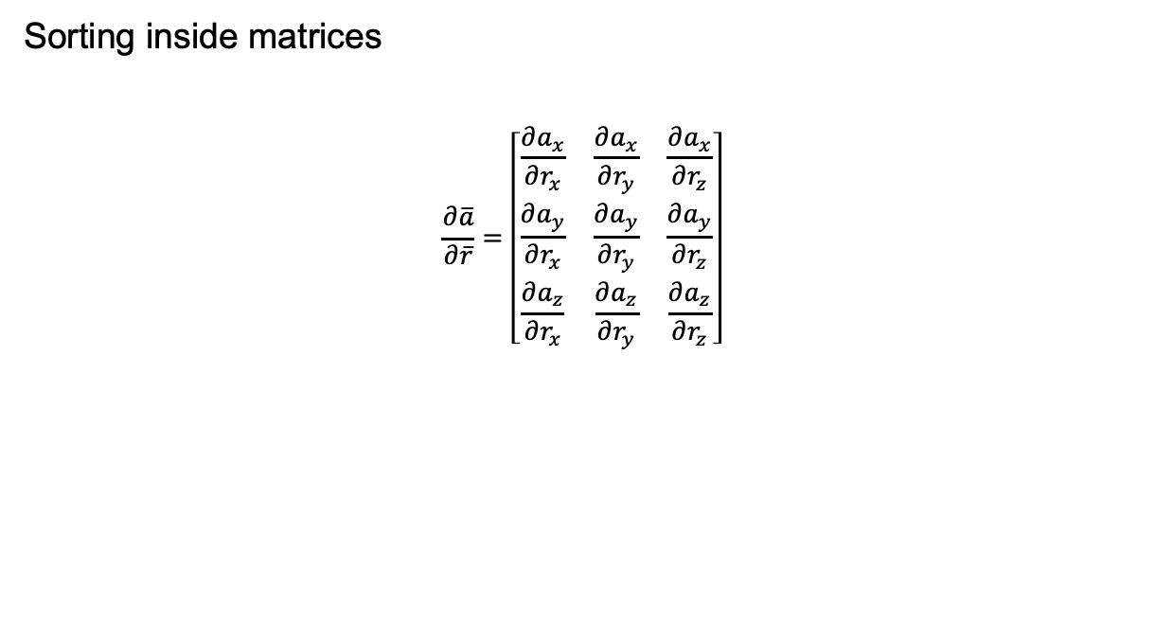

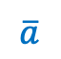
State transition matrix and sensitivity matrix
Sorting inside matrices
$$\frac{∂\overline{a}}{∂\overline{r}}=\left[\begin{matrix}\frac{∂a_{x}}{∂r_{x}} & \frac{∂a_{x}}{∂r_{y}} & \frac{∂a_{x}}{∂r_{z}} \\ \frac{∂a_{y}}{∂r_{x}} & \frac{∂a_{y}}{∂r_{y}} & \frac{∂a_{y}}{∂r_{z}} \\ \frac{∂a_{z}}{∂r_{x}} & \frac{∂a_{z}}{∂r_{y}} & \frac{∂a_{z}}{∂r_{z}}\end{matrix}\right]$$
$$\overline{a}$$
$$\overline{r}$$

Slide 15
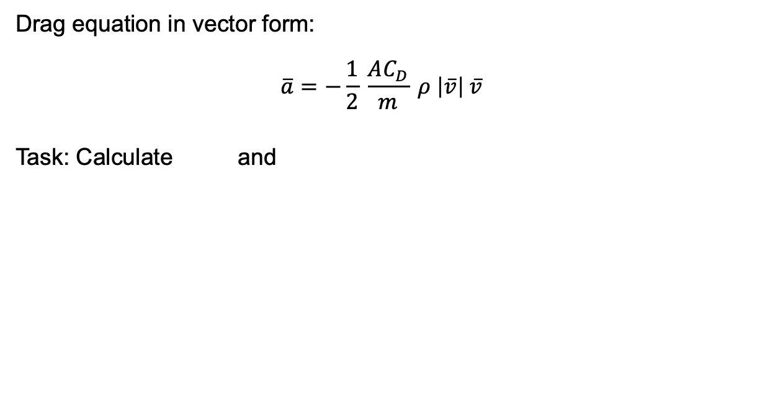
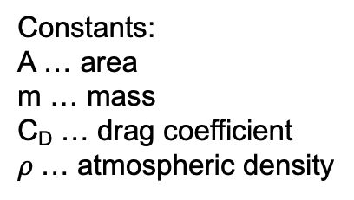

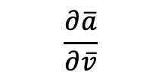
State transition matrix and sensitivity matrix
Drag equation in vector form:
$$\overline{a}=−\frac{1}{2} \frac{AC_{D}}{m} ρ \left|\overline{v}\right| \overline{v}$$
Task: Calculate and
Constants:
A … area
m … mass
C_{D} … drag coefficient
$ρ$… atmospheric density
$$\frac{∂\overline{a}}{∂\overline{v}}$$
$$\frac{∂\overline{a}}{∂\overline{r}}$$
Let see how much time you need
(max 10 minutes)

Slide 16
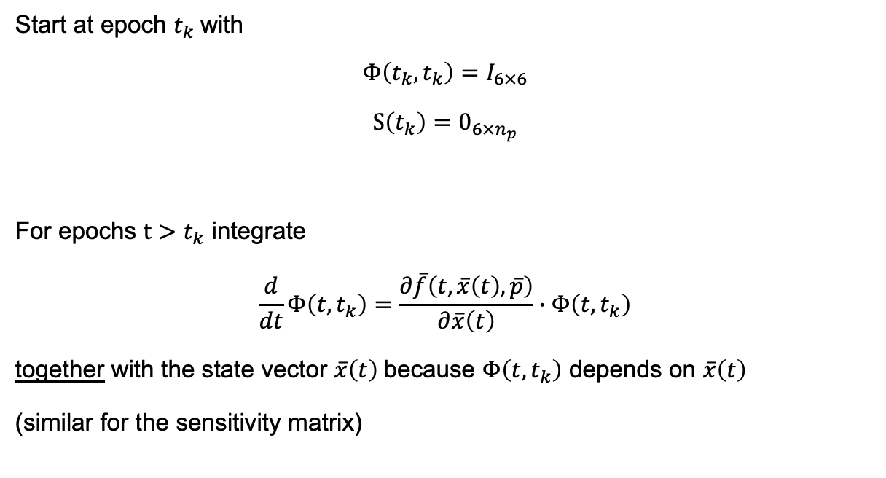
How to integrate the matrices and the state vector?
The initial state is the initial state itself
→ Identity matrix
Start at epoch $t_{k}$with
$$Φ\left(t_{k},t_{k}\right)=I_{6×6}$$
$$S\left(t_{k}\right)=0_{6×n_{p}}$$
For epochs $t>t_{k}$ integrate
$$\frac{d}{dt}Φ\left(t,t_{k}\right)=\frac{∂\overline{f}\left(t,\overline{x}\left(t\right),\overline{p}\right)}{∂\overline{x}\left(t\right)}∙Φ\left(t,t_{k}\right)$$
together with the state vector $\overline{x}\left(t\right)$ because $Φ\left(t,t_{k}\right)$ depends on $\overline{x}\left(t\right)$
(similar for the sensitivity matrix)
The initial state does not depend on the forces acting along the orbit
→ Zero matrix

Slide 17
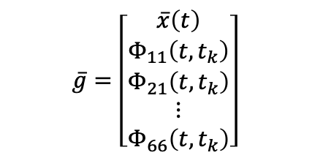



How to integrate the matrices and the state vector?
Arrange all differential equations in one vector (any sorting will work):
Plug this into the function for numerical integration
In the function for calculating the differential, you can sort back and forth
The function will return a vector, which you can sort back
Matlab: (Python: numpy.reshape)
Phi = reshape(Phi,36,1) … from 6 x 6 matrix to 36 x 1 vector
Phi = reshape(Phi,6,6) … from 36 x 1 vector to 6 x 6 matrix
$$\overline{g}=\left[\begin{matrix}\overline{x}\left(t\right) \\ Φ_{11}\left(t,t_{k}\right) \\ \begin{aligned}Φ_{21}\left(t,t_{k}\right) \\ ⋮ \\ Φ_{66}\left(t,t_{k}\right)\end{aligned}\end{matrix}\right]$$
State vector
First column of matrix $Φ\left(t,t_{k}\right)$
$$⋮$$
Last column of matrix $Φ\left(t,t_{k}\right)$

Slide 18
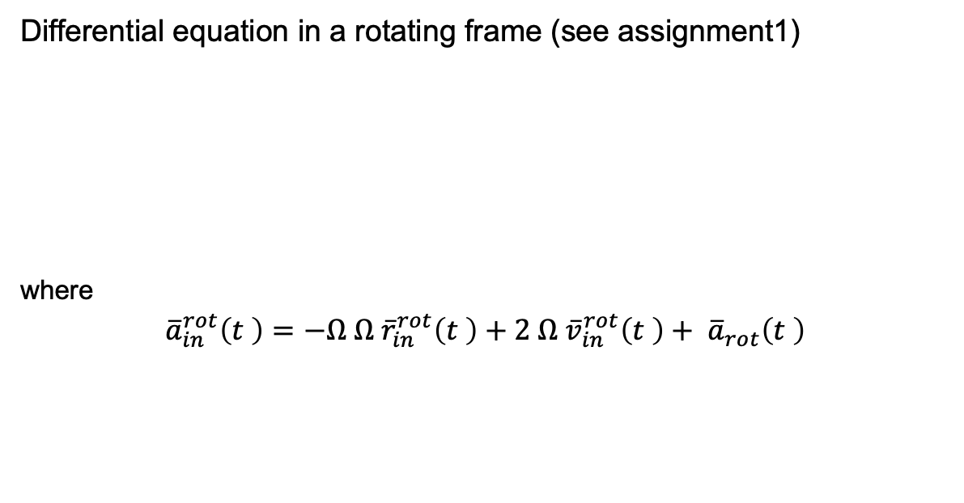
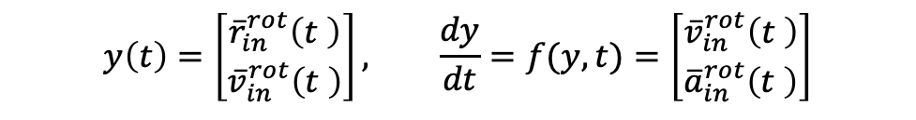
Acceleration in rotating reference frame
Differential equation in a rotating frame (see assignment1)
where
$${\overline{a}}_{in}^{rot}\left(t \right)=−Ω Ω {\overline{r}}_{in}^{rot}\left(t \right)+2 Ω {\overline{v}}_{in}^{rot}\left(t \right)+ {\overline{a}}_{rot}\left(t \right)$$
$$y\left(t\right)=\left[\begin{matrix}{\overline{r}}_{in}^{rot}\left(t \right) \\ {\overline{v}}_{in}^{rot}\left(t \right)\end{matrix}\right], \frac{dy}{dt}=f(y,t)=\left[\begin{matrix}{\overline{v}}_{in}^{rot}\left(t \right) \\ {\overline{a}}_{in}^{rot}\left(t \right)\end{matrix}\right]$$
Position and velocity as observed in the rotating frame
Acceleration as observed in the rotating frame
Acceleration in the rotating frame
(e.g., Earth’s gravity)

Slide 19

Combining dynamics and observations
Now we know how to predict $\overline{x}\left(t\right)$
Step 2: Update $\hat{x}\left(t\right)$ using observations
$$\overline{x}\left(t_{k}\right)=\left[\begin{matrix}\overline{r}(t_{k}) \\ \overline{v}(t_{k})\end{matrix}\right]$$
Step 1: Predict $\overline{x}\left(t\right)$ from $\overline{x}\left(t_{k}\right)$ and dynamics

Slide 20
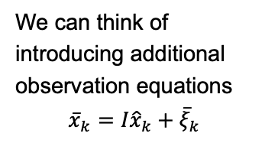
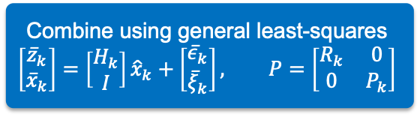
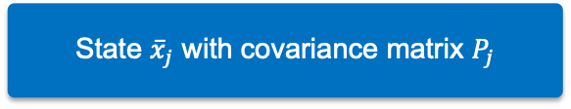
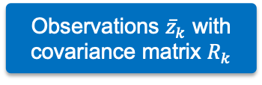
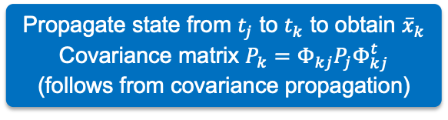
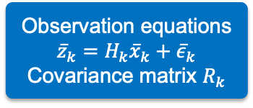
Sequential parameter estimation
We will only estimate position and velocity, so let us simplify the notation:
$$\overline{y}=\overline{x}\left(t_{k}\right)={\overline{x}}_{k}$$
$$Φ_{kj}=\text{Φ}\text{(}t_{k},t_{j}\text{)}$$
Observations ${\overline{z}}_{k}$ with
covariance matrix $R_{k}$
State ${\overline{x}}_{j}$ with covariance matrix $P_{j}$
Observation equations
$${\overline{z}}_{k}=H_{k}{\overline{x}}_{k}+{\overline{ε}}_{k}$$
Covariance matrix $R_{k}$
Propagate state from $t_{j}$ to $t_{k}$ to obtain ${\overline{x}}_{k}$ Covariance matrix $P_{k}=Φ_{kj}P_{j}Φ_{kj}^{t}$
(follows from covariance propagation)
We can think of introducing additional observation equations
$${\overline{x}}_{k}=I{\hat{x}}_{k}+{\overline{ξ}}_{k}$$
Combine using general least-squares
$$\left[\begin{matrix}{\overline{z}}_{k} \\ {\overline{x}}_{k}\end{matrix}\right]=\left[\begin{matrix}H_{k} \\ I\end{matrix}\right]{\hat{x}}_{k}+\left[\begin{matrix}{\overline{ε}}_{k} \\ {\overline{ξ}}_{k}\end{matrix}\right], P=\left[\begin{matrix}R_{k} & 0 \\ 0 & P_{k}\end{matrix}\right]$$

Slide 21
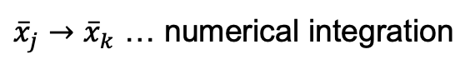
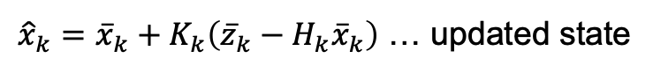
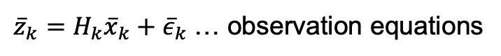
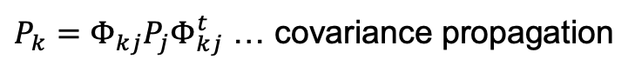
Kalman filter
Lecture notes
Chapters
10.3.5 – 10.3.7
Kalman reformulated the problem into a two-step procedure
Propagation
${\overline{x}}_{j}→{\overline{x}}_{k}$ … numerical integration
$P_{k}=Φ_{kj}P_{j}Φ_{kj}^{t}$ … covariance propagation
Update
${\overline{z}}_{k}=H_{k}{\overline{x}}_{k}+{\overline{ε}}_{k}$ … observation equations
$K_{k}=P_{k}H_{k}^{t}{\left(H_{k}P_{k}H_{k}^{t}+R_{k}\right)}^{−1}$ … Kalman gain matrix
${\hat{x}}_{k}={\overline{x}}_{k}+K_{k}\left({\overline{z}}_{k}−H_{k}{\overline{x}}_{k}\right)$ … updated state
${\hat{P}}_{k}=\left(I−K_{k}H_{k}\right)P_{k}$ … covariance matrix of updated state

Slide 22


A note on the state transition matrix
Remember how the state transition matrix was defined:
We may interpret that the state transition matrix relates a change in $\overline{x}(t_{k})$ to a change in $\overline{x}(t_{j})$:
Therefore, we can use the state transition matrix for error propagation:
However, $Φ_{kj} \overline{x}(t_{j})=\overline{x}\left(t_{k}\right)$ is incorrect. We can obtain $\overline{x}\left(t_{k}\right)$ only by numerically integrating from $\overline{x}(t_{j})$.
$$Φ_{kj}=\text{Φ}\text{(}t_{k},t_{j}\text{)}=\frac{∂\overline{x}(t_{k})}{∂\overline{x}(t_{j})}$$
$$Φ_{kj} d\overline{x}(t_{j})=d\overline{x}(t_{k})$$
$$P_{k}=Φ_{kj}P_{j}Φ_{kj}^{t}$$

Slide 23
Kalman filter vs. recursive parameter estimation
The Kalman filter can be derived from recursive parameter estimation. The derivations are too lengthy to show here. You can find them, for example, in this book:
K. R. Koch: Parameter Estimation and Hypothesis Testing in Linear Models. Second edition, 1999, Springer.
Chapters 1.3.4 on matrix identities and 3.2.8 on recursive parameter estimation are relevant. The ebook is available in TU Delft’s library.
You do not need to study this background information to complete the assignment. I provide it because I was asked a few times how to derive the Kalman gain matrix.

Slide 24












Linearized vs. extended Kalman filter
The observation equations are typically non-linear in satellite orbit determination, so we need to linearize them. Here, we have two options:
Linearized Kalman filter
Extended Kalman filter
Integrate reference orbit $\overline{x}\left(t\right)$ → use $\overline{x}\left(t\right)$ as Taylor point for linearization
Use updated state $\hat{x}\left(t\right)$ as Taylor point for linearization
$$\hat{x}\left(t_{1}\right)$$
$$\hat{x}\left(t_{1}\right)$$
update
$$\hat{x}\left(t_{2}\right)$$
update
update
$$\hat{x}\left(t_{2}\right)$$
update
propagate
propagate
$$\overline{x}\left(t_{1}\right)$$
propagate
propagate
$$\overline{x}\left(t_{1}\right)$$
$$\overline{x}\left(t_{2}\right)$$
$$\overline{x}\left(t_{0}\right)$$
$$\overline{x}\left(t_{2}\right)$$
$$\overline{x}\left(t_{0}\right)$$

Slide 25

Linearized vs. extended Kalman filter
State transition matrix
When using the reference orbit for linearization:
Start integration at $t_{0}$with $Φ\left(t_{0},t_{0}\right)=I$ and integrate $Φ\left(t,t_{0}\right)$ together with state vector $\overline{x}\left(t\right)$to obtain $Φ\left(t_{k},t_{0}\right)$
Then,$Φ_{kj}=Φ\left(t_{k},t_{j}\right)=Φ\left(t_{k},t_{0}\right) {Φ\left(t_{j},t_{0}\right)}^{−1}$
When using the updated state for linearization:
Restart integration at every epoch $t_{j}$, i.e., $Φ\left(t_{j},t_{j}\right)=I$, and integrate to epoch $t_{k}$ to obtain $Φ_{kj}=Φ\left(t_{k},t_{j}\right)$

Slide 26


Assignment 3: extended Kalman filter
Lecture notes
Chapters
10.3.5 – 10.3.7
Procedure step-by-step walkthrough
Given: ${\overline{x}}_{0}$, $P_{0}$, $R_{0}$
Update with observations ${\overline{z}}_{0}$
[Apply corrections for light time and relativity effects]
Calculate design matrix $H_{0}$ and $∆{\overline{z}}_{0}={\overline{z}}_{0}−{\overline{h}}_{0}{(\overline{x}}_{0})$
Calculate Kalman gain matrix $K_{0}=P_{0}H_{0}^{t}{\left(H_{0}P_{0}H_{0}^{t}+R_{0}\right)}^{−1}$
Update state ${\hat{x}}_{0}={\overline{x}}_{0}+K_{0}∆{\overline{z}}_{0}$
Update covariance matrix ${\hat{P}}_{0}=\left(I−K_{0}H_{0}\right)P_{0}$
Note where the transpose is and that $P_{0}$ is not inverted

Slide 27

Assignment 3: extended Kalman filter
Lecture notes
Chapters
10.3.5 – 10.3.7
Procedure step-by-step walk through
Propagate to next epoch $t_{1}$
Initialize $Φ\left(t_{0},t_{0}\right)=I$
Integrate together from $t_{0}$to $t_{1}$
${\hat{x}}_{0}$ to obtain ${\overline{x}}_{1}$
$Φ\left(t_{0},t_{0}\right)$ to obtain $Φ_{1,0}=Φ\left(t_{1},t_{0}\right)$
Propagate covariance matrix $P_{1}=Φ_{1,0}{\hat{P}}_{0}Φ_{1,0}^{t}$

Slide 28

Assignment 3: extended Kalman filter
Lecture notes
Chapters
10.3.5 – 10.3.7
Procedure step-by-step walkthrough
Update with observations ${\overline{z}}_{1}$
[Apply corrections for light time and relativity effects]
Calculate design matrix $H_{1}$ and $∆{\overline{z}}_{1}={\overline{z}}_{1}−{\overline{h}}_{1}{(\overline{x}}_{1})$
Calculate Kalman gain matrix $K_{1}=P_{1}H_{1}^{t}{\left(H_{1}P_{1}H_{1}^{t}+R_{1}\right)}^{−1}$
Update state ${\hat{x}}_{1}={\overline{x}}_{1}+K_{1}∆{\overline{z}}_{1}$
Update covariance matrix ${\hat{P}}_{1}=\left(I−K_{1}H_{1}\right)P_{1}$

Slide 29

Assignment 3: extended Kalman filter
Lecture notes
Chapters
10.3.5 – 10.3.7
Procedure step-by-step walkthrough
Propagate to next epoch $t_{2}$
Initialize $Φ\left(t_{1},t_{1}\right)=I$
Integrate together from $t_{1}$to $t_{2}$
${\hat{x}}_{1}$ to obtain ${\overline{x}}_{2}$
$Φ\left(t_{1},t_{1}\right)$ to obtain $Φ_{2,1}=Φ\left(t_{2},t_{1}\right)$
Propagate covariance matrix $P_{2}=Φ_{2,1}{\hat{P}}_{1}Φ_{2,1}^{t}$

Slide 30





Extended Kalman filter
Lecture notes
Chapters
10.3.5 – 10.3.7
Start: choose ${\overline{x}}_{0}$, $P_{0}$
For assignment 3,
I did this for you
Set $k=0$
Apply corrections for light time and relativity effects
End
Set $k=k+1$
Update
Calculate $H_{k}$, $∆{\overline{z}}_{k}={\overline{z}}_{k}−{\overline{h}}_{k}{(\overline{x}}_{k})$, $K_{k}=P_{k}H_{k}^{t}{\left(H_{k}P_{k}H_{k}^{t}+R_{k}\right)}^{−1}$
Update state vector ${\hat{x}}_{k}={\overline{x}}_{k}+K_{k}∆{\overline{z}}_{k}$
Update covariance matrix ${\hat{P}}_{k}=\left(I−K_{k}H_{k}\right)P_{k}$
Yes
Last epoch?
No
Propagation
Initialize $Φ_{k,k}=I$
Integrate ${\hat{x}}_{k}$ → ${\overline{x}}_{k+1}$, $Φ_{k,k}$ → $Φ_{k+1,k}$
Propagate covariance matrix $P_{k+1}=Φ_{k+1,k}{\hat{P}}_{k}Φ_{k+1,k}^{t}$

Slide 31
Kalman filter
Lecture notes
Chapters
10.3.5 – 10.3.7
In non-linear least-squares, you would perform several iterations until the procedure converges
The linearization is handled differently in the Kalman filter:
At each epoch, linearization is performed once
The procedure convergences as it moves forward to the next epochs
→ When using a “bad” initial guess to initialize the Kalman filter, you will see the linearization error at the first epoch and how it decreases over the following epochs

Slide 32
Kalman filter – Process noise
Lecture notes
Chapter 10.3.6
Kalman filter becomes inert to new observations
The reason is that the covariance matrix of the state gets too small
Temperature (°C)
STD of temp. (°C)
Observations
State
Time (s)
Time (s)
Temp. change (°C/s)
STD of temp. change (°C)
Time (s)
Time (s)

Slide 33

Kalman filter – Process noise
Lecture notes
Chapter 10.3.6
As we include more observations in the estimation at each update step, the covariance matrix ${\hat{P}}_{j}$ gets smaller, and so does the covariance matrix $P_{k}=Φ_{kj}{\hat{P}}_{j}Φ_{kj}^{t}$
However, the observation covariance matrix does not get smaller as we move forward (typically)
As the Kalman filter gets more “confident” in the propagated state, it becomes inert to new observations

Slide 34

Kalman filter – Process noise
Lecture notes
Chapter 10.3.6
The solution is to tell the Kalman filter that it should not get too confident by adding the process noise covariance matrix:
$$P_{k}=Φ_{kj}P_{j}Φ_{kj}^{t}+Q_{k}$$
This prevents that the covariance matrix $P_{k}$ gets too small and so the Kalman filter remains sensitive to new observations
Pitfall: Do not add random noise to the state!
(Note: The lecture notes write $Γ_{kj}Q_{k}Γ_{kj}^{t}$, but we simplify this to $Q_{k}$)

Slide 35
Kalman filter – Process noise
Lecture notes
Chapter 10.3.6
Kalman filter remains sensitive to new observations
The process noise covariance matrix prevents that the covariance matrix of the state gets smaller than a certain value
Temperature (°C)
STD of temp. (°C)
Observations
State
Time (s)
Time (s)
Temp. change (°C/s)
STD of temp. change (°C)
Time (s)
Time (s)

Slide 36

Assignment 3
Construct covariance matrices
Integrate state transition matrix
Implement and run Kalman filter
Analyse position and velocity errors
Linear vs. extended Kalman filter
Effect of process noise
Interpret size of observation residuals
More accurate dynamical model
For task f, you may use $Q_{k}=\left[\begin{matrix}σ_{a}^{2}I_{3×3} & 0_{3×3} \\ 0_{3×3} & σ_{b}^{2}I_{3×3}\end{matrix}\right]$with suitably chosen $σ_{a}^{2}$ and $σ_{b}^{2}$, representing the process noise variance in position and velocity, respectively

Slide 37

Light time and relativistic corrections, GPS clock offsets, and GOCE receiver clock offsets have already been applied
What? | Variable | Unit | System | Files
Speed of light | $$c$$ | km/s |  | 299792.458 km/s
Earth rotation rate | $$ω_{E}$$ | rad/s |  | 7.292115e-5 rad/s
Epochs | $$t$$ | s | GPS time | t.txt
Pseudorange observations | $$ρ\left(t\right)$$ | km |  | CA_range.txt
PRN of tracked GPS satellites |  |  |  | PRN_ID.txt
Positions of the GPS satellites (transmitters) | $$r_{t}\left(t\right)$$ | km | ECEF frame | rx_gps.txt, ry_gps.txt, rz_gps.txt
Velocities of the GPS satellites (transmitters) | $$v_{t}\left(t\right)$$ | km/s | ECEF frame | vx_gps.txt, vy_gps.txt, vz_gps.txt
The following variables are provided only for comparison and debugging
Precise positions of the GOCE satellite (receiver) | $$r_{r}\left(t\right)$$ | km | ECEF frame | rx.txt, ry.txt, rz.txt
Precise velocities of the GOCE satellite (receiver) | $$v_{r}\left(t\right)$$ | km/s | ECEF frame | vx.txt, vy.txt, vz.txt
ECEF = Earth-fixed Earth-centered frame (international terrestrial reference frame)

